Slide 1




Slide 2
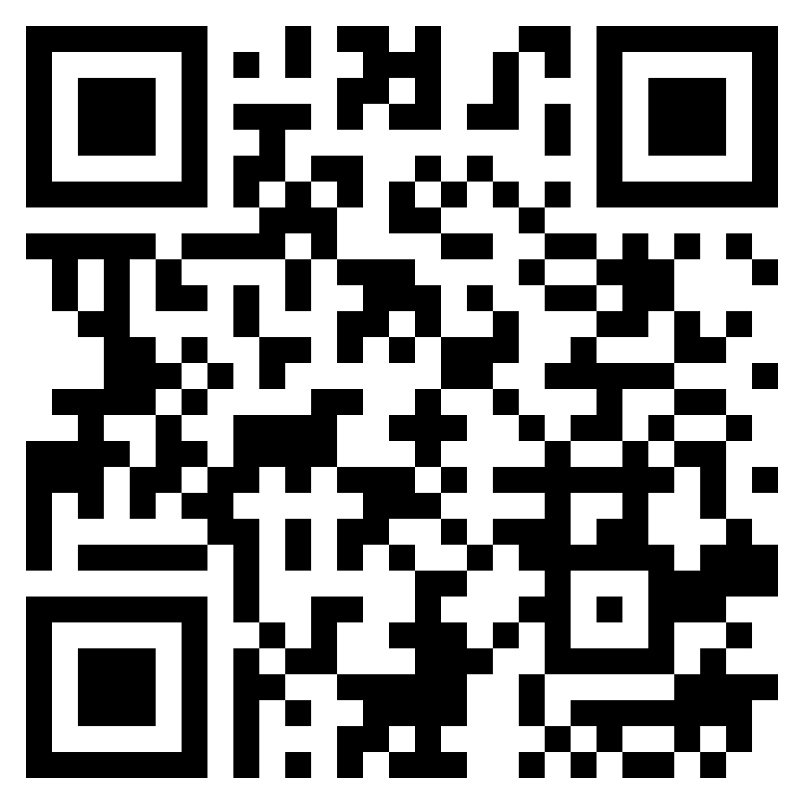
TEST TIME ON PERMUTATIONS AND COMBINATIONS-1
URL:https://forms.gle/rA2Qp7v9DtuQTNdx8
QR CODE:

Slide 3

PERMUTATION AND COMBINATION-1

Slide 4
PERMUTATION AND COMBINATION
Multiplication Theorem:
If an operation can be performed in m different ways and following which a
second operation can be performed in n different ways, then the two operations
in succession can be performed in m×n different ways.
Addition Theorem (Fundamental Principles of Counting)
If an operation can be performed in m different ways and a second independent
operation can be performed in n different ways, either of the two operations can
be performed in (m+n) ways
Factorial
Let n be a positive integer. Then n factorial can be defined as
n!=n(n−1)(n−2)⋯

Slide 5
Special Cases
0!=1
1!=1
Permutation formula:
Permutation is defined as arrangement of r things that can be done out of total n
things. This is denoted by ^{n}P_{r} which is equal to n!/(n-r)!
Combination formula:
Combination is defined as selection of r things that can be done out of total n
things. This is denoted by ^{n}C_{r} which is equal to n!/r!(n-r)!

Slide 6
The different arrangements of a given number of things by taking some or all at a time, are called permutations.
^{n} P_{r} = n! / (n – r)!
There are basically two types of permutation:
Repetition is Allowed
n × n × ... (r times) = n^{r}
No Repetition
n!/(n − r)!

Slide 7
Each of the different groups or selections which can be formed by taking some or all of a number of objects is called a combination.
^{n} C _{r} = n! / [ r ! x (n – r)! ]
Note:
^{n} C _{n} =1 and ^{n} C ₀ =1
^{n} C _{r=} ^{n} C _{(n-r)}

Slide 8
Question: 01
Out of 7 consonants and 4 vowels, how many words of 3 consonants and 2
vowels can be formed?
24400
21300
210
25200
Answer : D

Slide 9
Explanation:01
Number of ways of selecting 3 consonants out of 7 = 7C3
Number of ways of selecting 2 vowels out of 4 = 4C2Number of ways of selecting
3 consonants out of 7 and 2 vowels out of 4 = 7C3 x 4C2
=(7×6×5/3×2×1)×(4×3/2×1)=210
It means that we can have 210 groups where each group contains total 5 letters
(3 consonants and 2 vowels).
Number of ways of arranging 5 letters among themselves =
5! = 5 x 4 x 3 x 2 x = 120 Hence, Required number of ways = 210 x 120 = 25200

Slide 10
Question: 02
From a group of 7 men and 6 women, five persons are to be selected to form a committee so that at least 3 men are there on the committee. In how many ways. Can itbe done?
624
702
756
812
Answer : C

Slide 11
Explanation:02
From a group of 7 men and 6 women, five persons are to be selected with at least 3
men. Hence we have the following 3 choices We can select 5 men ——(Option 1) Number of ways to do this = 7C5
We can select 4 men and 1 woman ——(Option 2) Number of ways to do this = 7C4 x 6C1
We can select 3 men and 2 women ——(Option 3) Number of ways to do this = 7C3 x 6C2
Total number of ways = 7C5 + [7C4 x 6C1] + [7C3 x 6C2] = 7C2 + [7C3 x 6C1] + [7C3 x 6C2] [Applied the formula nCr = nC(n – r) ]
=[7×62×1]+[(7×6×53×2×1)×6]+[(7×6×53×2×1)×(6×52×1)]
= 21 + 210 + 525 = 756

Slide 12
Question: 03
What is the rank of a word "SMART" using permutations?
79
90
78
80
Answer : A

Slide 13
Explanation:03
Dictionary order of letters
AMRST
A _ _ _ _ = 4!= 24 words
M _ _ _ _ = 4!= 24 words
R _ _ _ _ = 4!= 24 words
SA _ _ _ = 3! = 6 words
SMA R T = 0! = 1 words
= 24 + 24 + 24 + 6 + 1
=79

Slide 14
Question: 04
In how many ways can be the letter of the word ‘STRANGE’ be arranged so that
(a) The vowel may appear in the odd places
(b) The vowels are never separated
(c) The vowels never come together
1340,1650,4720
1420,1540,4800
1620, 2120,4200
1440,1440,3600
Answer : D

Slide 15
Explanation:04
For finding number of ways of placing n things in r objects, we use
npr=n!/(n-1)!
Also, for arranging n objects without restrictions, we have n! ways.
(a) There are 7 letters in the word ‘STRANGE’ amongst which 2 are vowels and there are 4 odd places (1, 3, 5, 7) where these two vowels are to be placed together.
Total number of ways can be expressed by replacing n = 4 and r = 2,
4p2=4!/(4−2)!=4!/2!=(4×3×2!)/2!=4×3=12
And corresponding to these 12 ways the other 5 letters may be placed in 5! ways
=5×4×3×2×1=120
=5×4×3×2×1=120.
Therefore, the total number of required arrangements =
12×120=1440 ways.

Slide 16
Explanation:04
(b) Now, vowels are not to be separated. So, we consider all vowels as a single letter.
There are six letters S, T, R, N, G, (AE) , so they can arrange themselves in 6! ways and two vowels can arrange themselves in 2! ways.
Total number of required arrangements
=6!×2!=6×5×4×3×2×1×2×1=1440ways.
(c) Now, for the number of arrangements when all vowels never come together, we subtract the total arrangement where all vowels have occurred together from the total number of arrangements.
The total number of arrangements = 7! = 5040 ways
And the number of arrangements in which the vowels do not come together
=7!−6!2!
=7!−6!2!
number of arrangements in which the vowels do not come together
=5040−1440=3600
=5040−1440=3600 ways.

Slide 17
Question: 05
How many 3-letter words with or without meaning, can be formed out of the
letters of the word, ‘LOGARITHMS’, if repetition of letters is not allowed?
720
420
None of these
5040
Answer : A

Slide 18
Explanation:05
The word ‘LOGARITHMS’ has 10 different letters. Hence, the number of
3-letter words(with or without meaning) formed by using these letters = 10P3 = 10 x 9 x 8 = 720

Slide 19
Question: 06
If all the permutations of the letters of the word “AGAIN” are arranged in a dictionary, then 50th word is
A.NAAGI
B.NAGAI
C.NAAIG
D.NAIAG
Answer : C

Slide 20
Explanation:06
Complete step-by-step answer:
As the are placed in alphabetical order so the number of words start with letter A is given by:
Number of words that can be formed with A at first position
=4!=24
Rest of the letters can be placed at first place and let us see how many words are formed from them respectively. G letter will come after A letter. So, number of words formed with first letter G is given by
Number of words that can be formed with G at first position
= 4!/2!
= (4×3×2×1)/(2×1)
=12
Here you can see we divide
4! by 2!
2! why? The reason behind that is that there are two A letters in the word given to us. So, to avoid repetition of words and the position of the last word appear in a dictionary whose first letter G can be given by the addition of number of words formed by A and I i.e.
⇒The number of words till G letter at starting =
24+12=36
24+12=36.

Slide 21
Similarly, the number of words formed with first letter I is given by
Number of words that can be formed with I at first position
=4!/2!
=(4×3×2×1)/(2×1)
=12
Hence, you can find the position of last word start with letter I i.e.
⇒ The number of words till I letter at starting =
24+12+12=48
24+12+12=48.
Now you can see the first 48 words appearing in a dictionary are from the words starting with letter A, I, G. After that the next two words i.e. word at 49th and 50th position have starting letter N.
So, look at the first two words that appear in the dictionary starting with the N alphabet are NAAGI and NAAIG in alphabetically order respectively.
Here, the word at 50th position is NAAIG.
Hence the correct option is C.

Slide 22
Question: 07
In how many different ways can the letters of the word ‘DETAIL’ be
arranged such that the vowels must occupy only the odd positions?
None of these
120
64
36
Answer : D

Slide 23
Explanation:07
The word ‘DETAIL’ has 6 letters which has 3 vowels (EAI) and 3 consonants(DTL)The 3 vowels(EAI) must occupy only the odd positions. Let’s mark the positions as (1) (2) (3) (4) (5) (6). Now, the 3 vowels should only occupy the 3 positions marked as (1),(3) and (5) in any order. Hence, number of ways to arrange these vowels = 3P3 = 3! = 3 x 2 x 1 = 6 Now we have 3 consonants(DTL) which can be arranged in the remaining 3 positions in any order Hence, number of ways to arrange these consonants = 3P3 = 3! = 3 x 2 x 1 = 6
Total number of ways = number of ways to arrange the vowels x number of ways to arrange the consonants = 6 x 6 = 36

Slide 24
Question: 08
A bag contains 2 white balls, 3 black balls and 4 red balls. In how many way can 3 balls be drawn from the bag, if at least one black ball is to be included in the draw?
64
28
32
None of these
Answer : A

Slide 25
Explanation:08
Explanation :
From 2 white balls, 3 black balls and 4 red balls, 3 balls are to be selected such that at least one black ball should be there. Hence we have 3 choices as given below We can select 3 black balls ————————–(Option 1) We can select 2 black balls and 1 non-black ball——(Option 2) We can select 1 black ball and 2 non-black balls——(Option 3)
Number of ways to select 3 black balls = 3C3
Number of ways to select 2 black balls and 1 non-black ball = 3C2 x 6C1
Number of ways to select 1 black ball and 2 non-black balls = 3C1 x 6C2
Total number of ways = 3C3 + (3C2 x 6C1) + (3C1 x 6C2) = 1 + (3C1 x 6C1) + (3C1 x 6C2) [Applied the formula nCr = nC(n – r) ]
=1+[3×6]+[3×(6×52×1)]
= 1 + 18 + 45 = 64

Slide 26
Question: 09
If all the permutations of the letters of the word “AGAIN” are arranged in a dictionary, then 50th word is
A.NAAGI
B.NAGAI
C.NAAIG
D.NAIAG
Answer : A

Slide 27
Explanation:09
Here is the answer and explanation
Answer : Option A
Explanation :
A number is divisible by 5 if the its last digit is a 0 or 5
So last digit have one possibilities _ _ 1
As given in question no digit is repeated so 5*4*1=20

Slide 28
Question: 10
How many 6 digit telephone numbers can be formed if each number starts with 35 and no digit appears more than once?
720
360
1420
1680
Answer : D

Slide 29
Explanation:10
The first two places can only be filled by 3 and 5 respectively and there is only 1
Way of doing this Given that no digit appears more than once. Hence we have 8
digits remaining(0,1,2,4,6,7,8,9) So, the next 4 places can be filled with the
remaining 8 digits in 8P4 ways
Total number of ways = 8P4 = 8 x 7 x 6 x 5 = 1680

Slide 30
Question: 11
There are five visiting places in a city and can visit the 3 places on a day. Find the number of ways in which a visitor can visit these places in a day.
20
25
30
10
Answer : B

Slide 31
Explanation:11
the number of ways in which a visitor can visit the places are
5c1 + 5c2+ 5c3= 5 +10+10
=25 ways

Slide 32
Question: 12
In how many ways the 18 English and 12 Hindi books can be kept on the shelf so that two books on Hindi may not be together
15400
50388
93564
none of these
Answer : B

Slide 33
Explanation:12
in order that no two Hindi come together we need to have following arrangement.
X E X E X E X……….E X
There are 18 English books so places needs to be is 19
And for the Hindi books 12 places are used 19c12 = 50388 ways

Slide 34
Question: 13
There are 10 students in a dance group, out of which 6 are too selected in a row
such that two of them will not be able to participate together. Find the number of
ways in which 8 can be selected.
144
732
728
398
Answer : C

Slide 35
Explanation:13
let there be students A to j out of which A and b don’t participate together,
Case 1: neither of A and B come then the remain students’ needs to be selected
8c6
Case 2: only one of them comes i.e. selecting 5 out of 8 and one from A and b 8c6 + 8c5 x 2c1 =728 ways

Slide 36
Question: 14
How many positive integers not more than 4300 of digits 0, 1, 2, 3, 4 if repetition
is allowed?
625
560
565
575
Answer : D

Slide 37
Explanation:14
one digit no =4 (0 is not a positive integer)
two digit no=4*5=20
three digit no=4*5*5=100
four digit no=3*5*5*5=375(the possibility for 1,2,3 will come in the first position)
four digit no=1*3*5*5 (the possibility of 4is fixed in the first position and then
0,1,2is comes in second position)and the last digit is 4300 we include this
number also Ans is 4+20+100+375+75+1=575

Slide 38
Question: 15
A number plate can be formed with two alphabets followed by two digits with no Repetition then how many possible combinations can we get?
67600
64320
58500
65000
Answer : C

Slide 39
Explanation:15
no. of alphabets=26 (a-z), no. of digits=10(0-9). ways of arranging two alphabets with out repetition=26*25; ways of forming two digits without repetition=10*9 no. of combinations of forming the number on number plate= 26*25*10*9=58500

Slide 40
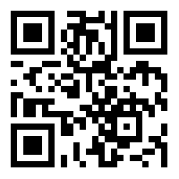
https://learn.codemithra.com

Slide 41




THANK YOU
+91 78150 95095
codemithra@ethnus.com
www.codemithra.com

